Slide 1
Scaling Rectified Flow Transformers for High-Resolution Image Synthesis (SD3)
Patrick Esser * Sumith Kulal Andreas Blattmann Rahim Entezari Jonas Muller Harry Saini Yam Levi ¨
Dominik Lorenz Axel Sauer Frederic Boesel Dustin Podell Tim Dockhorn Zion English
Kyle Lacey Alex Goodwin Yannik Marek Robin Rombach *
Stability AI

Slide 2

Prompt: Epic anime artwork of a wizard atop a mountain at night casting a cosmic spell into the dark sky that says "Stable Diffusion 3" made out of colorful energy

Slide 3
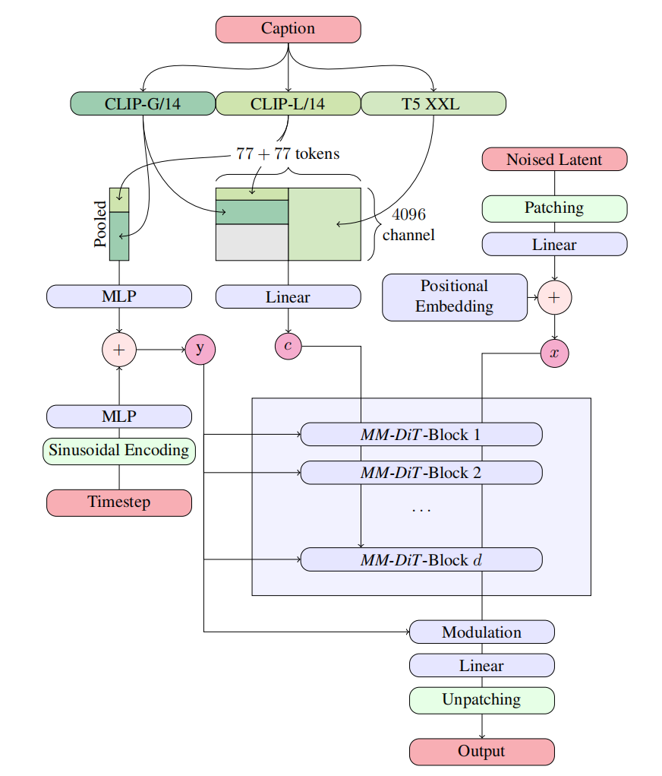
Text-to-Image Architecture
Multimodal Diffusion Backbone
pretrained autoencoder :
VAE image => latent representations
frozen text models:
Clip G, Clip L, T5-xxl text => text embedding

Slide 4
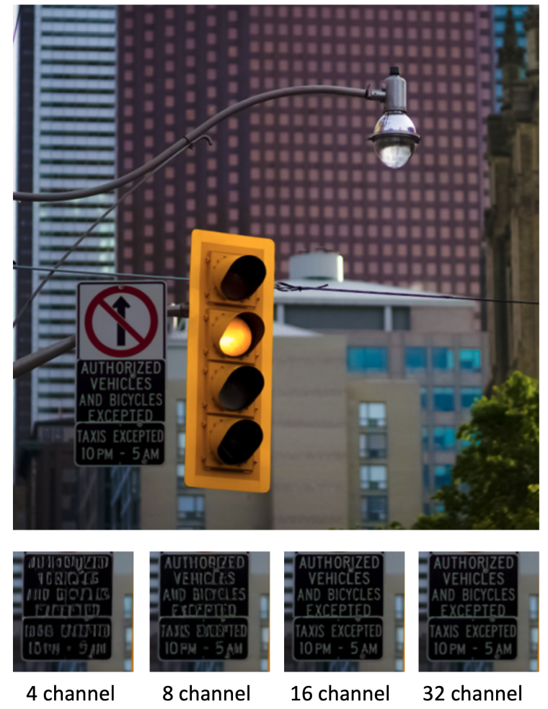
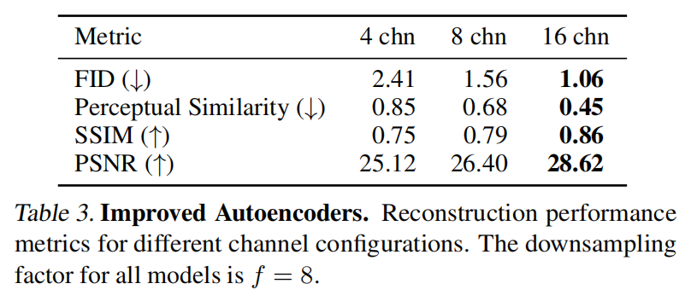
Improved Autoencoders
Compared different channels vae
SD3 use 16 channels vae
From Meta EMU paper

Slide 5
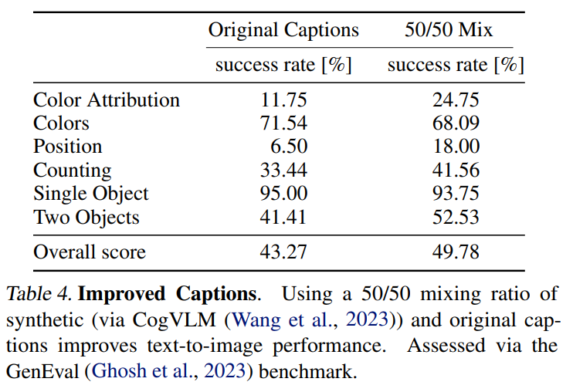
Improved Captions
Compared Original Captions and Mixed Captions
generated captions mixed with original captions
Some others model also used llm to generate detailed captions:
pixart-alpha
dalle 3
etc

Slide 6
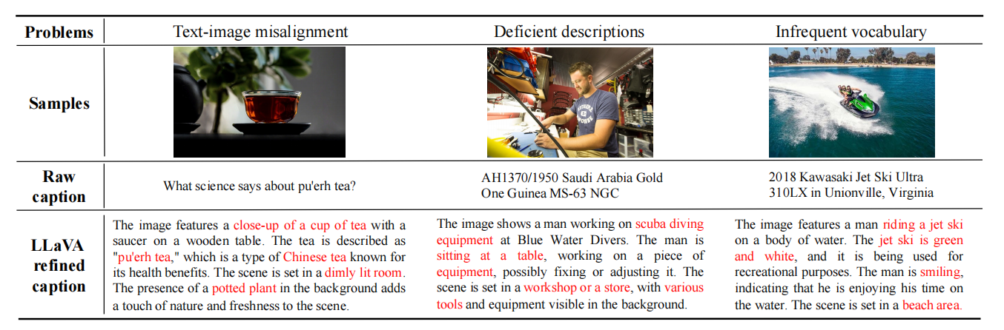
Captions Example
SD3 used CogVLM instead of LLaVa
Example from pixart-alpha

Slide 7
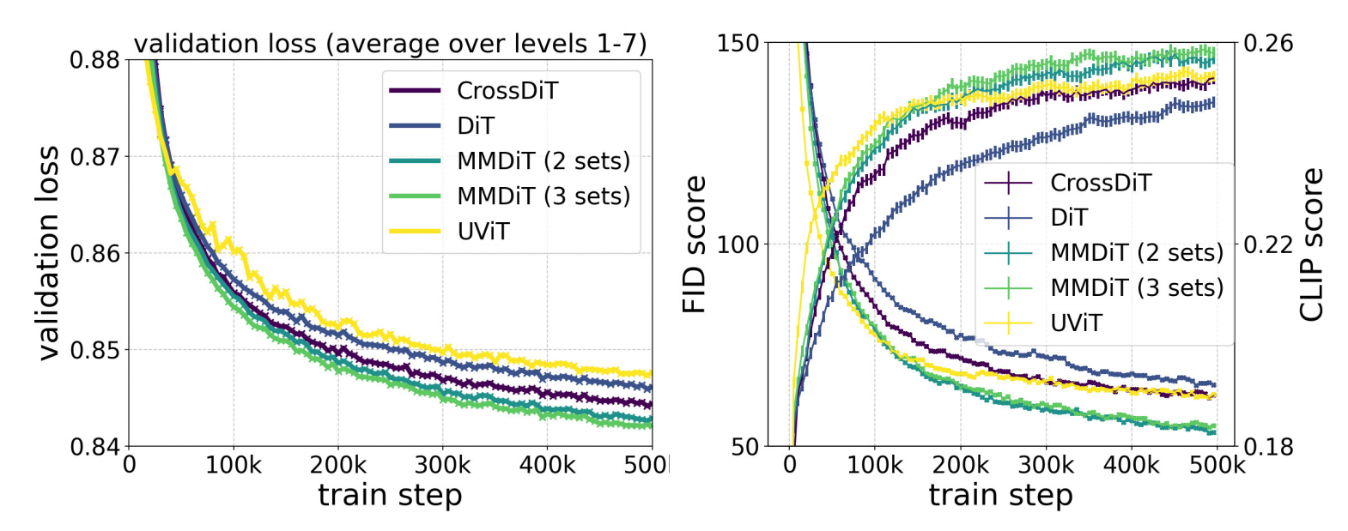
Improved Text-To-Image Backbones
MMDit (3 sets) > MMDit (2 sets) > CrossDit > UVit > Dit
MMDit (3 sets): clip, t5, image => cost ↑vram↑
MMDit (2 sets): text, image
Finally choosed MMDit (2 sets)
Pixart-alpha used CrossDit

Slide 8
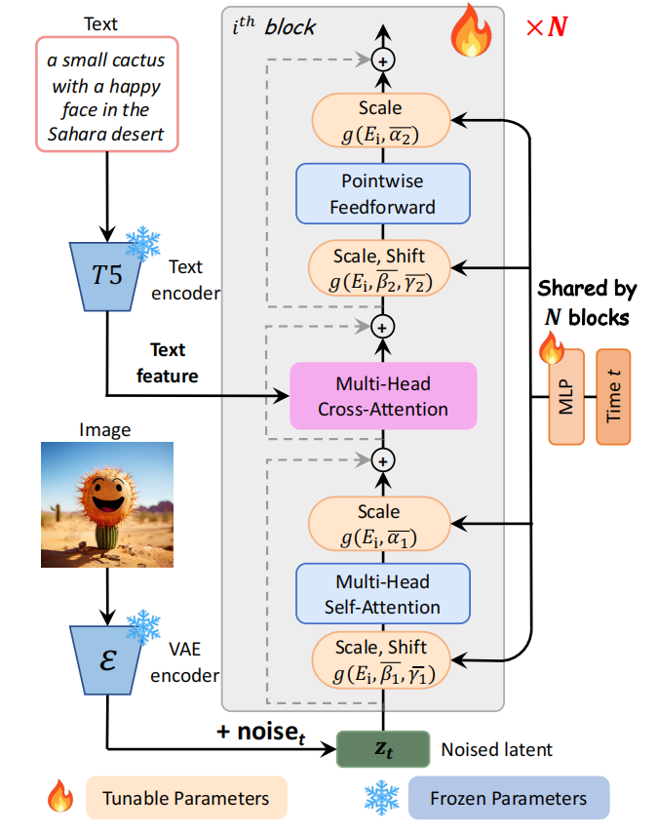
Pixart-alpha
Multi-Head Cross-Attention

Slide 9
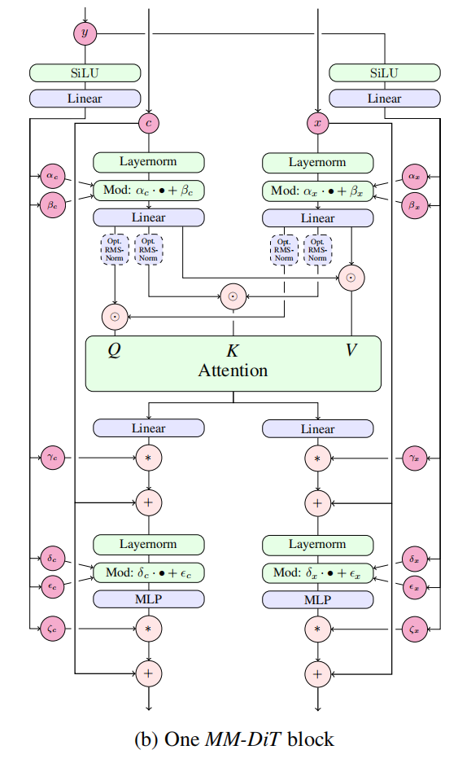
MMDit (2 sets) =>

Slide 10
Data Preprocessing
Pre-Training Mitigations
Filtered out:
Sexual content
NSFW-detection models
Low score on aesthetics
Rating systems
Duplication
Cluster-based deduplication
Precomputing Image and Text Embeddings
Cache Image and Text embeddings

Slide 11
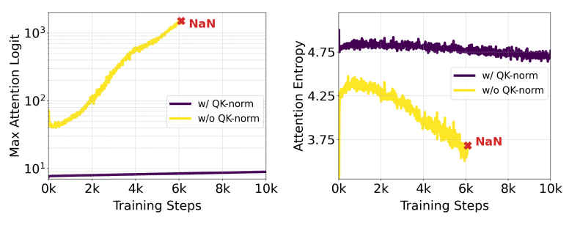
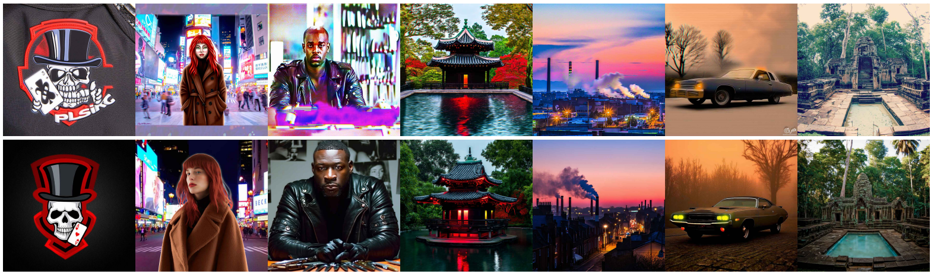
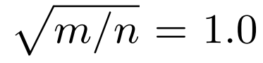
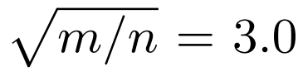
Training Detail
Pretrain at 256*256 pixels
Mixed precision training
Cause to entropy grows uncontrollably
Used RMSNorm on QK to avoid it
Bucketed sampling
Resolution-dependent shifting of timestep schedules

Slide 12
Train Detail
Using validation loss
Highly correlated to
Comprehensive evaluation metrics
GenEval
Human preference
Simple and general measure of model performance
EveryDream2 implemented validation loss for SD1.5
No SDXL support

Slide 13
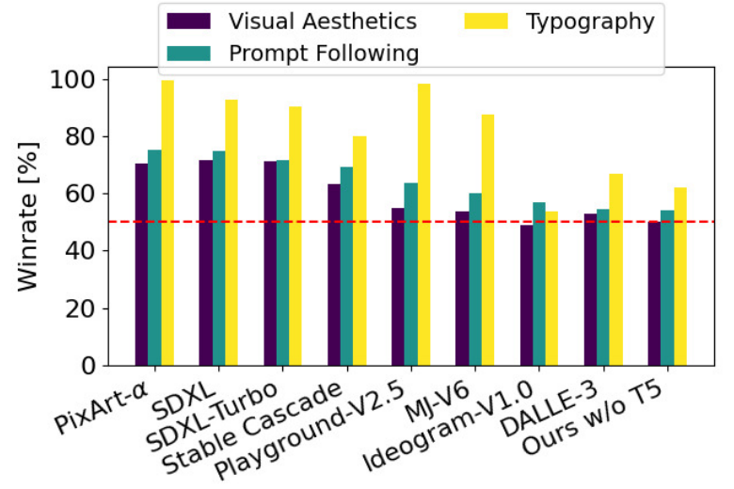
Evaluation
Human Preference Evaluation
Parti-prompts
visual quality
prompt following
typography generation

Slide 14
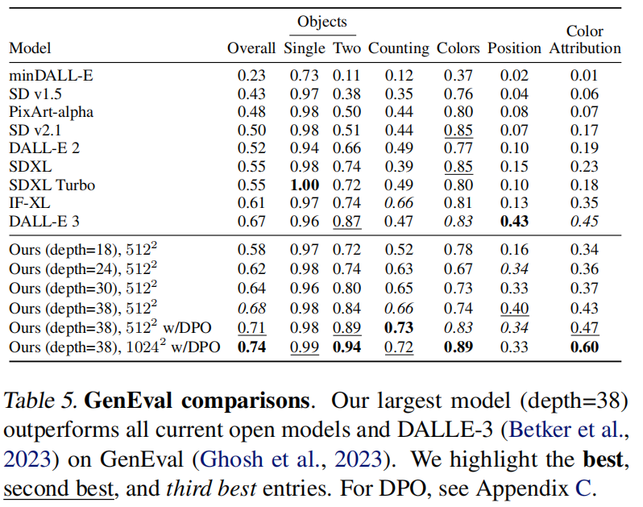
Evalution
Depth=38 Largest model is the new SOTA model in text to image generation field.
Dall-e 3 has better score on position. Might related to its synthesis dataset.

Slide 15
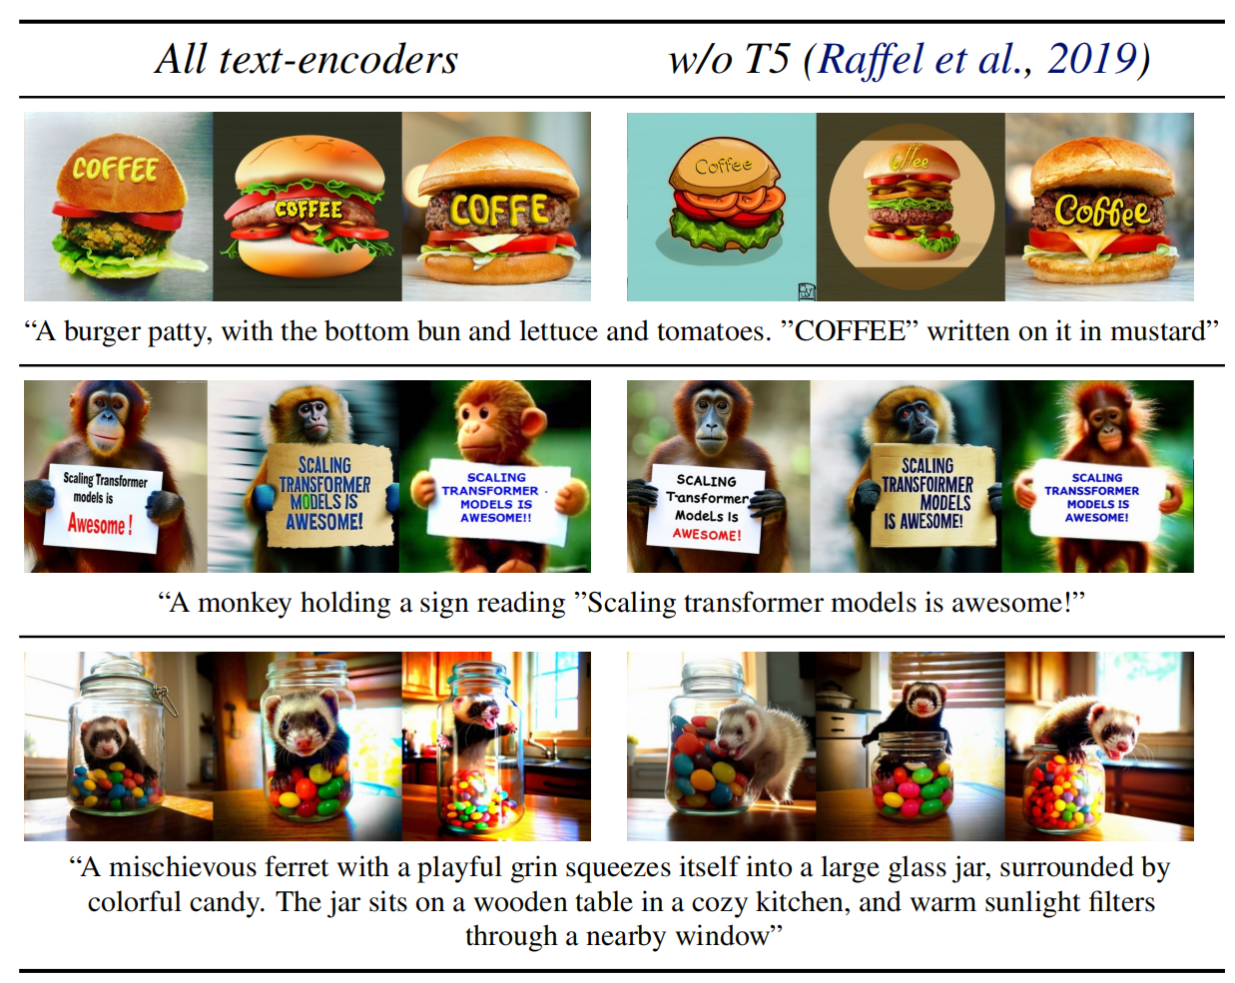
Flexible Text Encoders
Train with 3 Text Encoders
Individual drop-out rate of 46.3%
able to drop out T5 but keep running
T5: Important for complex prompt
high degree of detail
longer spelled text
Alternative:
store T5 in RAM
int 4

Slide 16
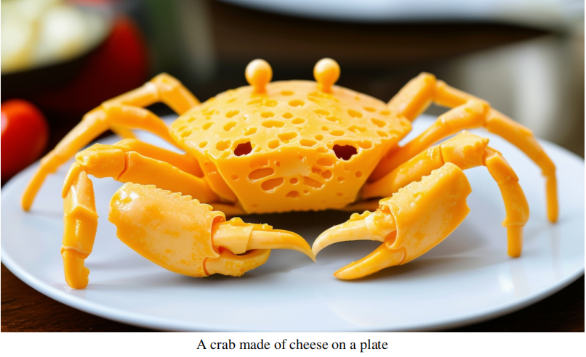
Prompt & Generation

Slide 17
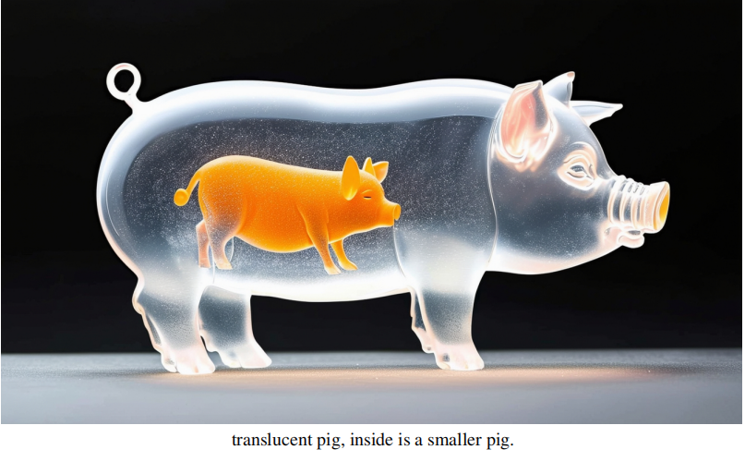
Prompt & Generation

Slide 18
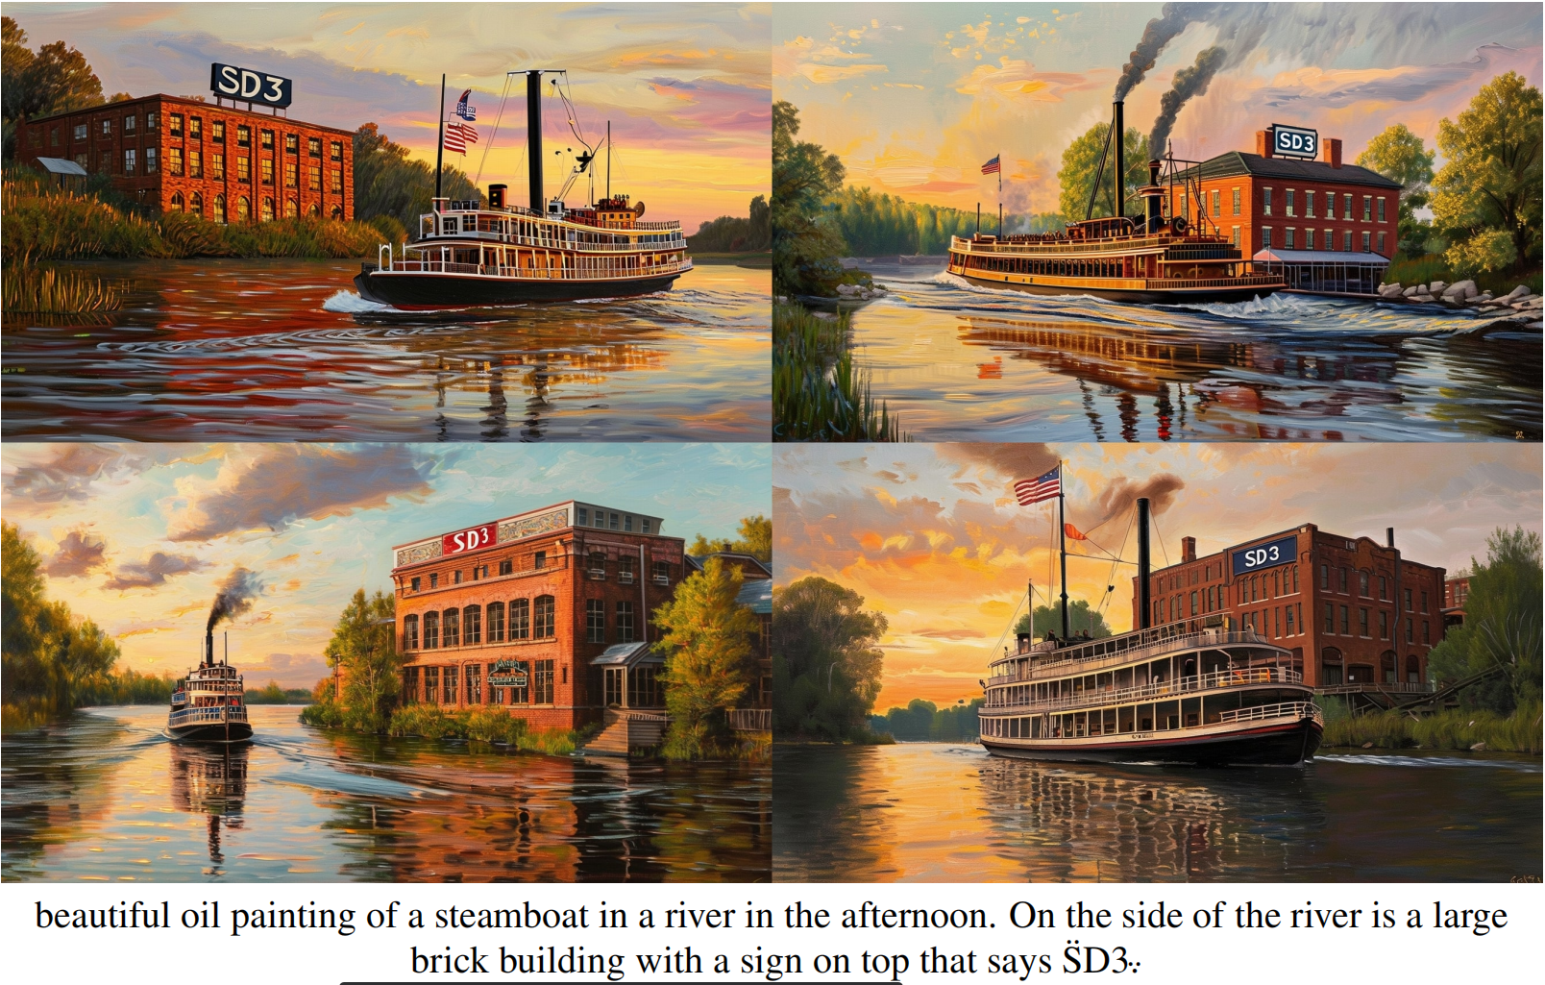
Prompt & Generation
Small text
16 channels vae

Slide 19
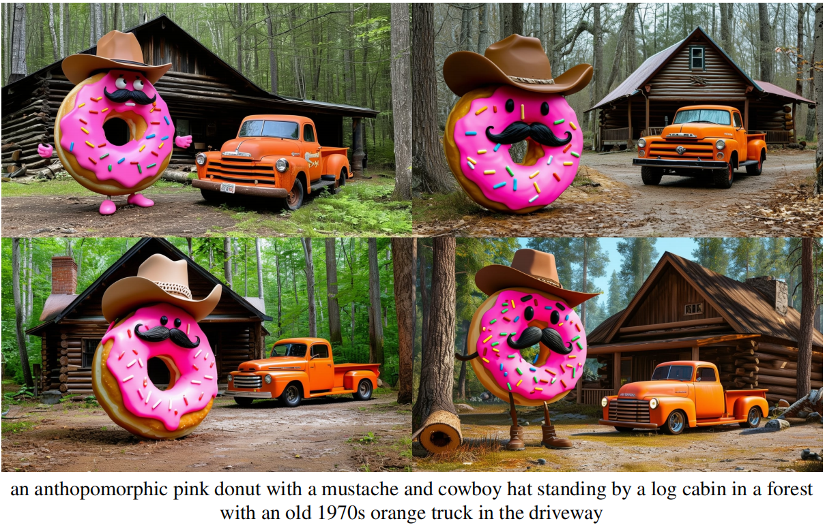
Prompt & Generation
Multiple Subject

Slide 20
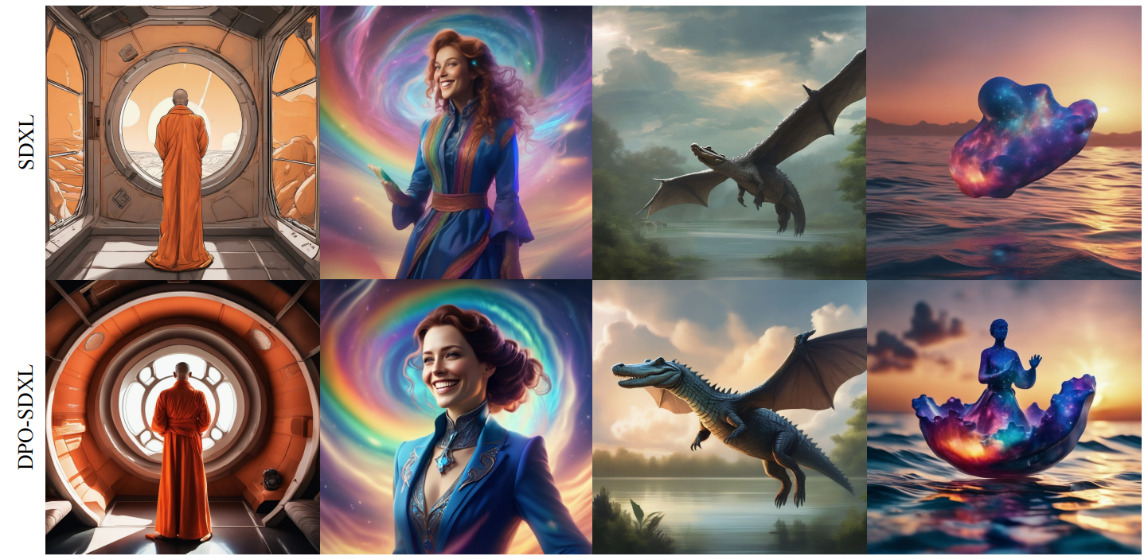
Direct Preference Optimization
Diffusion Model Alignment Using Direct Preference Optimization

Slide 21
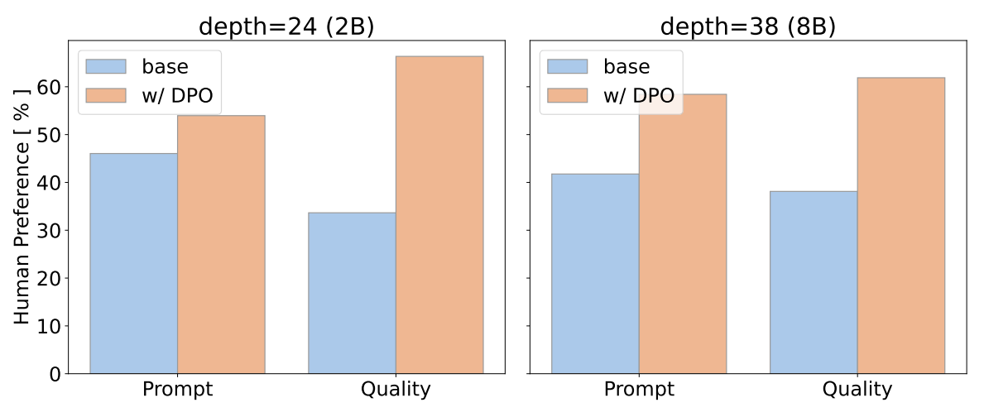
Direct Preference Optimization
Trained with Rank 128 Lora
4k steps for 2B model
2k steps for 8B model

Slide 22
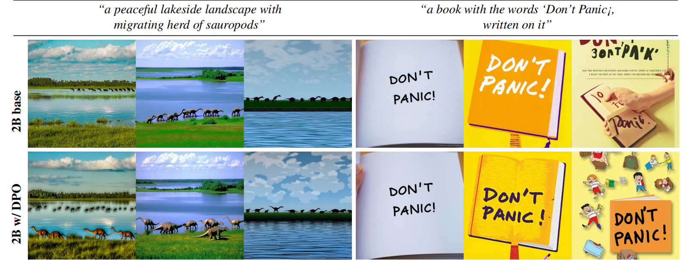
Direct Preference Optimization
2B model

Slide 23
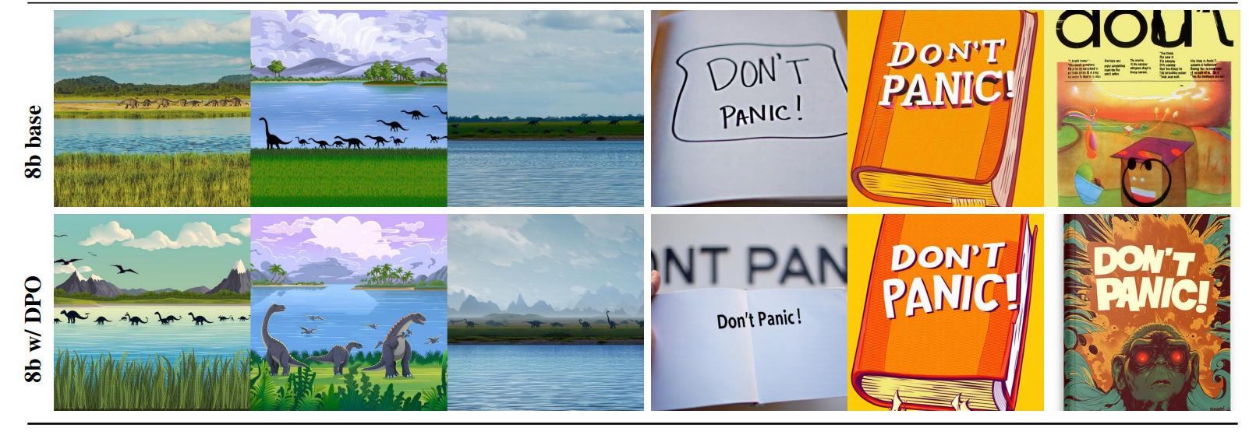
Direct Preference Optimization
8B Model

Slide 24
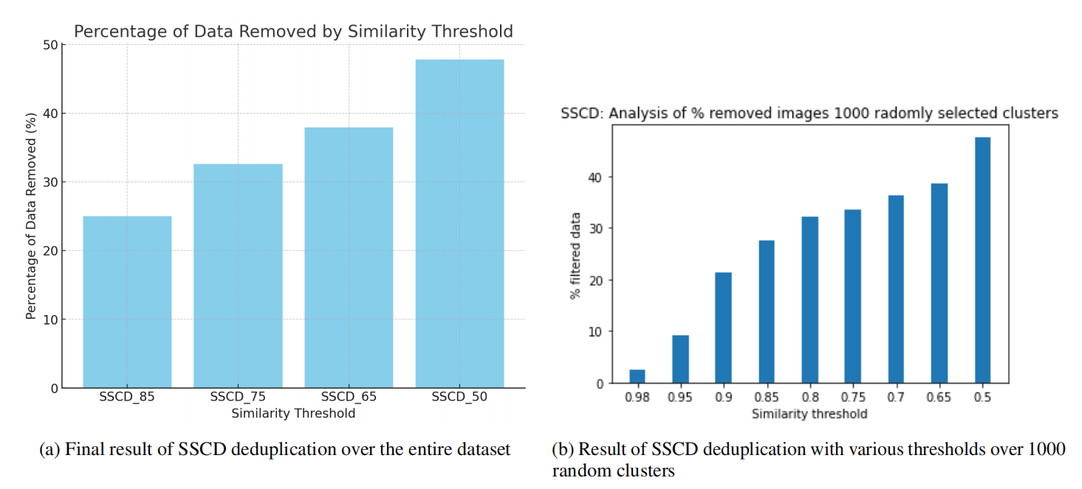
Details on Deduplication
SSCD
Backbone for the deduplication process
autofaiss (2023) for clustering
Facebook AI Similarity Search
Prevents memorization
Aims to learn not to copy

Slide 25
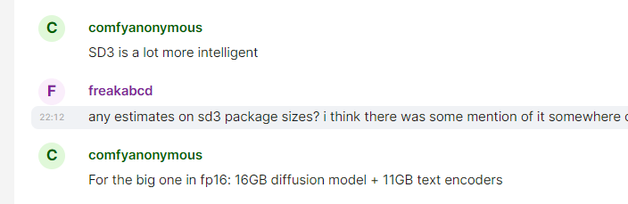
Hardware Estimation
T5-XXL FP32 ~20GB VRAM
fp16 ~10GB+clip L+clip G = 11GB
int 4 in RAM
remove
8B fp16 16GB VRAM
d = 38
2B fp16 4GB VRAM?
d = 24
8M fp16 1.6GB VRAM
d = 1x?

Slide 26
End
Thanks for watching

